Slide 1

Course15-“Infrared remote control”
Yahboom
Yahboom OMIBOX Tutorial

Slide 2
1
2
3
4
5
Learning
goals
Download
code
Experimental
phenomena
Preparation
程序编程
About code
Tencent
Yahboom OMIBOX Tutorial

Slide 3
1
Learning goals
1. The position of the Infrared receiver on the robot car
2. Learn about the Arduino Uno pins connected to the Infrared receiver of Omibox programmable robot
3. Learn about Infrared remote controller
Yahboom OMIBOX Tutorial

Slide 4


2
Preparation-1
As shown on the left figure above, the infrared receiver on the Omibox programmable robot circled by the red wire frame on the left.
As shown on the right figure above, infrared remote controller.
The infrared remote controller is used to send a signal to the infrared receiver, and the infrared receiver is used to receive the signal sent by the infrared remote controller.
Yahboom OMIBOX Tutorial

Slide 5
2
Preparation2
According to the hardware manual, we can know that infrared receiver is connected the A3 of the Arduino Uno.
Yahboom OMIBOX Tutorial

Slide 6
4
About code
Please see the IR.ino file for this experimental procedure.
Yahboom OMIBOX Tutorial

Slide 7


4
Download code
1.We need to open the code of this experiment: CarRun.ino, click“√” under the menu bar to compile the code, and wait for the word "Done compiling " in the lower right corner, as shown in the figure below.
2. Click 【Tools】 --- 【Board】 -- we need to choose Arduino Uno. As shown in the figure below.
Yahboom OMIBOX Tutorial

Slide 8


4
Download code
3.In the menu bar of Arduino IDE, we need to select 【Tools】---【Port】--- selecting the port that the serial number displayed by the device manager, as shown in the figure below.
4. After the selection is completed, you need to click “ → ”under the menu bar to upload the code to the Arduino UNO board. When the word “Done uploading” appears in the lower left corner, the code has been successfully uploaded to the Arduino UNO board, as shown in the figure below.
Yahboom OMIBOX Tutorial

Slide 9
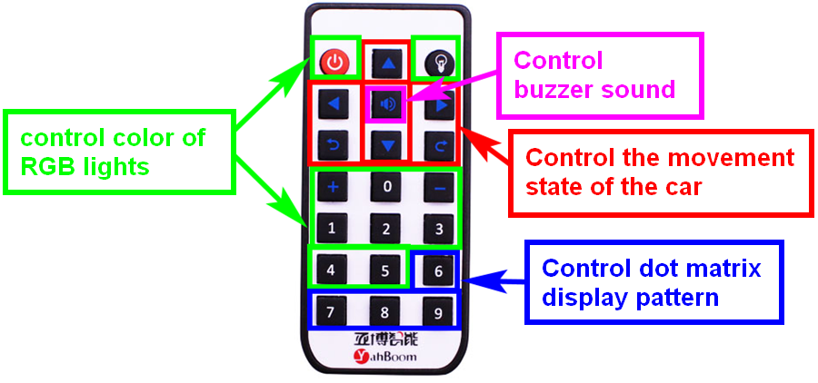
5
Experimental phenomena
After the program is uploaded, open the power of the robot car. Infrared remote controller can control robot car to complete the following function
Yahboom OMIBOX Tutorial

Slide 10
Inspire Creativity Embrace Innovation
Thank you!!!
Yahboom

